Slide 1
The All-In-One Network Monitoring Solution

Slide 2
Agenda
Why Network Monitoring?
How To Find The Right Solution?
PRTG Network Monitor
PRTG: The All-In License Model and Pricing
PRTG: Software Made in Germany
Customer Feedback

Slide 3
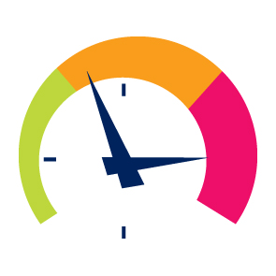
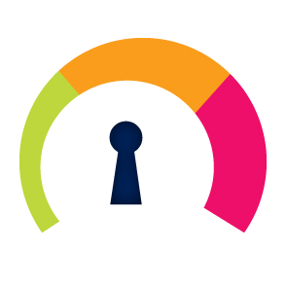
Why Network Monitoring?
Saves Time
Saves Money
Offers Security
Notes:
Network Monitoring Saves Time + Money
Malfunctions and failures in operational processes can result in loss of time and productivity as well as financial loss
Immediate alerting in the case of network issues
Fast identification of error sources
Network Monitoring Saves Money
“Time is money!”
Control of SLAs (Service level agreements)
Identification of actual needs (memory, bandwidth, hardware…) and planning of resources
Avoid outages of critical business components (e.g. web shop)
Network Monitoring Offers Security
Discovery of unusual activity (viruses, trojans…)
Alerting you to network issues >> no alert = no issue

Slide 4
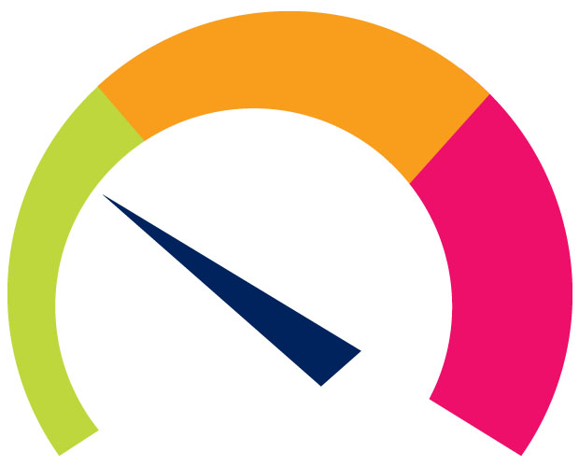
What Does Comprehensive Network Monitoring Do?
Measure
Inform and Alert
Analyse
Optimise
Notes:
Measure:
Traffic / Usage
Availability
Performance
Inform and Alert:
Alerts are sent to responsible person if any failure is detected
Thresholds inform the administrator about unusual activities, possible security threads etc. instantly
Information can be put together in individual, scheduled reports to inform the management or customers to justify IT investments or to prove provided services
Analyse:
The results of the monitoring can be analysed
Are the SLA kept?
Top-lists for different traffic pattern in the network (flow and packet sniffer data)
customised reports can be generated
Optimise:
Network monitoring results show how to strengthen the network by eliminating weak spots, security issues, failures, weak hardware
Results show redundant soft- and hardware to avoid expensive unused network components
Help to plan new investments (e.g. virtualisation)

Slide 5
Who Should Monitor?
“It showed us how we could make the most out of the resources we already have.“
Steven Tims, IT support services manager, Raven Industries
"Knowing that any issues with a system will be instantly emailed has brought peace of mind to our support.”
Michael Post, Operations
Director, Isys
“I am blown away by the performance here.”
Jon Berry, owner,
Green Olive Tree
Notes:
Monitoring is a must for every company that depends on its IT-infrastructure for organisation, sales, production, or any other purpose.
From home users and small companies to enterprise organisations
Independent from the industry the company or organisation is active in

Slide 6
How To Find The Right Solution?
Features
Usability
Scalability
Trial version
Licensing
Future demands
Support
Notes:
Selection criteria for the right monitoring software
Features and functionality:
What should the monitoring tool do?
How large is the existing network?
Is the network distributes over different locations?
Which kind of alerts and reports are needed?
Which language of the software is needed?
Usability
How long will installation and configuration take?
How difficult is the setup process and the everyday usage?
Scalability
Suitable for networks of all sizes
Trial version available?
Can this trial version be used as a commercial version after the purchase?
Sufficient information easily available
Features
Licensing model
Upgrading options
Support
Licensing
How transparent, easy to understand and fair is the pricing?
Does it cover future demands
New features, upgrades, updates?
Technical support available?
User manual, blog, forum, webinars, video tutorials, support line?

Slide 7
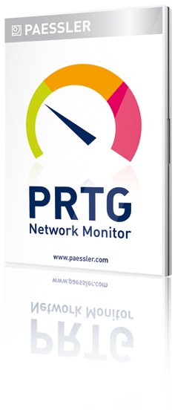
PRTG: Makes it Easy
Installed in Seconds
Configured in Minutes
Protects Networks for Years
Notes:
Installed In Seconds
Configured In Minutes
Protects Networks For Years

Slide 8
PRTG: Makes it Easy
Easy Testing
Easy Buying
Easy Monitoring
Notes:
Easy Testing
30-day trial version with no sensor limitation
Trial version can be converted to commercial version without loss of settings
Freeware available (10 sensors)
Easy Buying
All-in license – no add-ons or modules needed
12 months software maintenance and 30-day money-back guarantee inclusive
Easy upgrade to higher licenses (just pay the price difference)
Easy Monitoring
Optimized for easy installation, configuration and operation
Support via website, premium email support for customers
Multilingual software (9 languages) and support

Slide 9
PRTG: Your Benefits
Plan and optimise for the future
One single solution
Simple and fair licensing
Your entire network at a glance
Get up and running quickly
Reliable operation
Easy to use
React quickly to issues
Notes:
One single solution: Bandwidth, uptime, and performance monitoring
Your entire network at a glance: Monitor distributed IT infrastructures with remote probes
Reliable operation: High availability option via clustering
React quickly to issues: Receive alerts through email, SMS, pagers, etc.
Easy to use: User interfaces in multiple languages
Get up and running quickly: Easy download, installation, configuration
Simple and fair licensing: All-in license, no hidden costs, easy upgrades
Plan and optimise for the future: In-depth reporting and customisable dashboards

Slide 10
PRTG: The All-In License Model
Entire monitoring feature set
Licenses differ only by two parameters
Maximum number
of sensors
Number of allowed
core server installations
1st year maintenance included in price
= All-in. No hidden costs.
Notes:
PRTG: The All-In License Model
All PRTG licenses include the entire monitoring feature set and an unlimited number of remote probes as well as at least one failover node for clustering.
Licenses of PRTG differ only by two parameters
The maximum number of sensors (100/500/1000/2500/unlimited)
The number of allowed core server installations (1/unlimited/corporate)
Upgrades and Maintenance
Each PRTG license comes with 12 months maintenance included
Maintenance includes all updates and new versions
Upgrade possible at just the price difference without any risk
No add-ons. All-in. No hidden costs

Slide 11
PRTG: Licenses and Pricing
All PRTG licenses include the entire monitoring feature set:
Monitoring of multiple locations, virtual environments, xFlow monitoring, failover cluster etc.
No Add-ons. No Extra Modules. All-in.
Starts at EUR 330
Notes:
All PRTG licenses include the entire monitoring feature set, remote probes for the monitoring of distributed networks as well as at least one failover node for clustering.
The price starts at just 300 EUR

Slide 12
PRTG: Licenses and Pricing
PRTG License
Freeware Edition
30 Day Trial
PRTG Network Monitor 100
PRTG Network Monitor 500
PRTG Network Monitor 1000
PRTG Network Monitor 2500
PRTG Network Monitor 5000
PRTG Network Monitor Unlimited
PRTG Network Monitor Corporate Country*
PRTG Network Monitor Corporate 5 Core Global**
Sensors
10
unlimited
100
500
1000
2500
5000
unlimited
unlimited
unlimited
Prices
free
free
€ 330,-
€ 1.200,-
€ 2.000,-
€ 4.150,-
€ 7.000,-
€ 10.000,-
€ 30.000,-
€ 35.000,-
* The PRTG Corporate Country allows multiple installations of the core server in different sites of one corporation in one country.
** The PRTG Corporate 5 Core Global allows up to 5 installations of the core server in different sites of one corporation in different countries.
Notes:
All available licenses in detail.

Slide 13
PRTG: Software Made in Germany
Based in Nuremberg, Germany, Paessler has been at the forefront of providing the industry's most powerful, affordable and easy-to-use network solutions
since the dawn of the modern Internet.
Notes:
Based in Nuremberg, Germany, Paessler has been at the forefront of providing the industry's most powerful, affordable and easy-to-use network solutions since the dawn of the modern Internet.
100% owned by founders and employees
More than 50 employees from 10 nations
Development and support – all in-house in Germany
US-based sales and pre-sales support team
15 years of constant growth with 25–60% per year
More than 150,000 customer installations in more than 120 countries
Companies of all sizes and all industries
More than 70% of Fortune 100 Enterprises world-wide use one of our products
More than 2,000 authorized resellers world-wide

Slide 14
“Would you recommend PRTG to colleagues or friends?”
Don‘t know
2,6%
No
0,3%
Yes, very likely
17,2%
Have already recommended
39,5%
Yes, definitely
40,4%
Notes:
Based on a recent customer survey, 97% of our customers would recommend PRTG to colleagues or friends, or have already done so.

Slide 15
Thank You!
More Questions?
Paessler AG
Sales Team
sales@paessler.com
T: +49 911 93775-0
F: +49 911 93775-409
www.paessler.com
Notes:
Foto des Referenten auswechseln ! ! !

